Slide 1
Data Info
Query Output
Market Basket Analysis
Project
Basket Analysis
Dashboards
1
Page

Slide 2

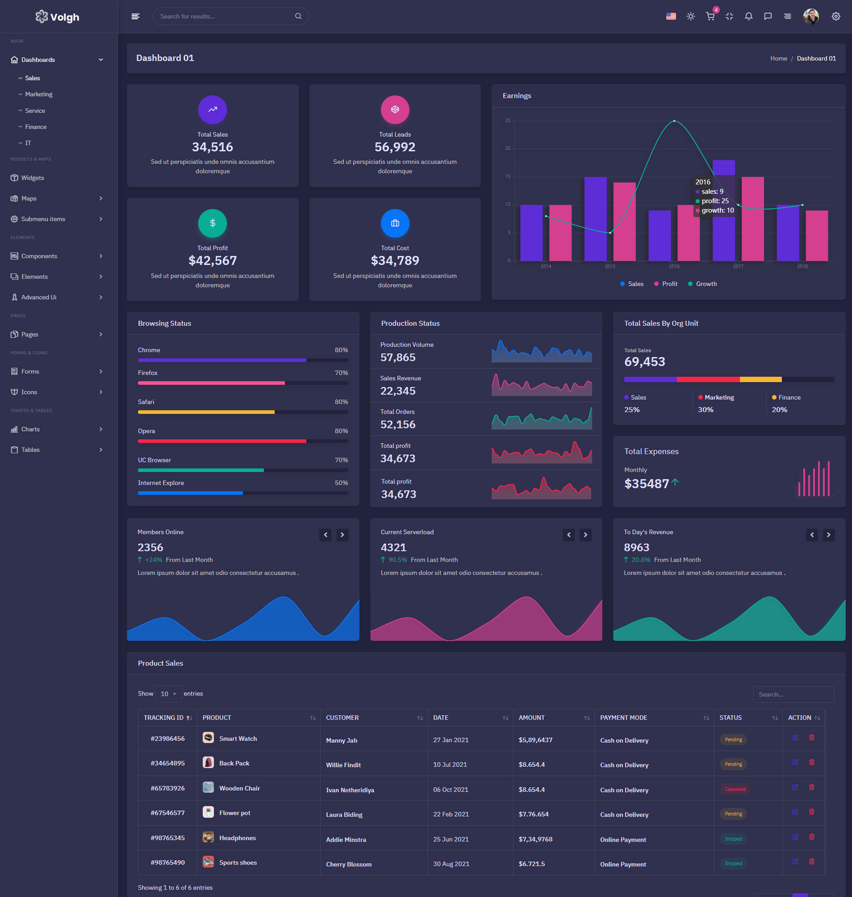
Market Basket Analysis
Market basket analysis is a method used in retail to uncover product relationships based on customer purchase patterns. By analyzing which items are frequently bought together, businesses gain insights into customer behavior and preferences, enabling them to optimize inventory, layout, and merchandising strategies. This analysis also supports cross-selling efforts by identifying opportunities to suggest complementary products, enhancing the shopping experience and driving revenue through targeted promotions and personalized recommendations.
This technique not only enhances the shopping experience for customers by suggesting complementary products but also empowers retailers to make data-driven decisions that drive efficiency, improve customer satisfaction, and ultimately boost revenue.
2
Page

Slide 3
Info & Resources
In MBA technique transactional GroceryData set used for analysis of customer purchase patterns.
There are number of algorithms used in this technique apriori , FP-growth , E-clat.
By Using apriori algorithm association rule (relations) are created with useful measures which are used to make data-driven decisions for retailers.
Jupyter Notebook - Market Basket Analysis on GroceryDataset
Network Graph using Power BI
3
Page

Slide 4

Measures of the effectiveness of association rules
Support is an indication of how frequently the items appear in the data.
Confidence shows us the probability that if you buy one product, you're likely to buy another. It helps us understand how connected certain products are in customers' shopping habits.
Lift can be used to compare confidence with expected confidence, or how many times an if-then statement is expected to be found true.
4
Page

Slide 5
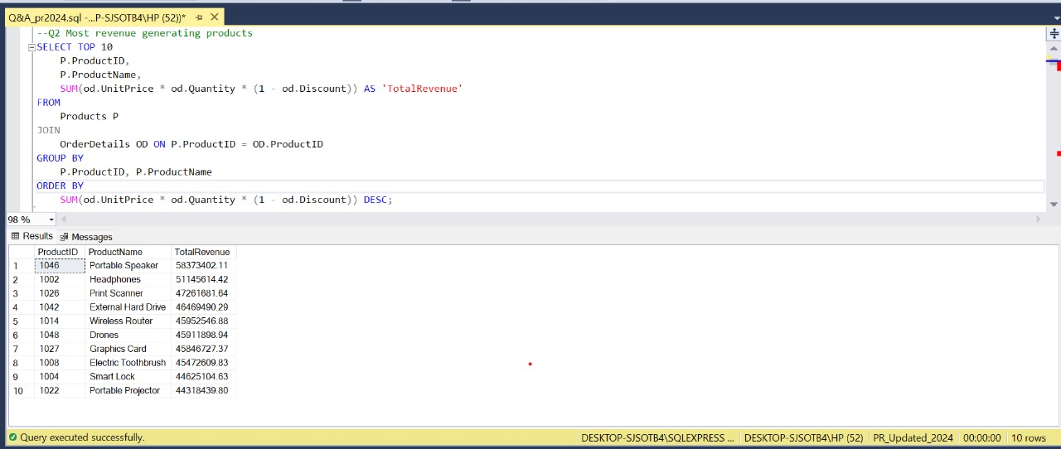
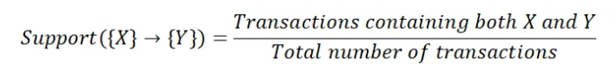
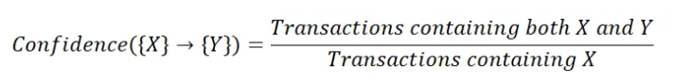
Support & Confidence
01
The support of an itemset is defined as the probability that the itemset is present in a transaction.
Formulae
02
Confidence measures the likelihood that if item A is purchased, item B will also be purchased.
5
Page
Notes:
https://unsplash.com/photos/lFhyR3GVOXE

Slide 6


LIFT
Lift measures how much more likely item B is to be bought when item A is bought, compared to when item B is bought without item A. It helps to determine the strength and significance of the association between items.
01
If the lift value is a negative value , then there is a negative correlation between datapoints, if the value is positive , there is a positive correlation.
02
Lift is the ratio of the observed frequency of co-occurrence of our items and the expected frequency.
03
6
Page

Slide 7
Example
Support({Bread}) = 13/20 = 0.65
Support({Milk}) = 5/20 = 0.25
Support({Bread, Milk}) = 4/20 = 0.2
Confidence({Bread} -> {Milk}) = Support({Bread, Milk}) / Support({Bread}) = 0.2 / 0.65 = 0.31
Lift({Bread} -> {Milk}) = Confidence({Bread} -> {Milk}) / Support({Milk}) = 0.31 / 0.25 = 1.24
This tells us how frequently each item or combination of items appears in the transactions.
This tells us the likelihood that Milk will be purchased when Bread is purchased
This means that when Bread is purchased, Milk is 1.24 times more likely to be purchased compared to when Milk is purchased independently.
7
Page

Slide 8
Thank You!
Have a Great Day

